Slide 1
Distributed Computing Seminar
Lecture 1: Introduction to Distributed
Computing & Systems Background
Christophe Bisciglia, Aaron Kimball, & Sierra Michels-Slettvet
Summer 2007
Except where otherwise noted, the contents of this presentation are © Copyright 2007 University of Washington and are licensed under the Creative Commons Attribution 2.5 License.

Slide 2
Course Overview
5 lectures
  1 Introduction
  2 Technical Side: MapReduce & GFS
  2 Theoretical: Algorithms for distributed computing
Readings + Questions nightly
  Readings: http://code.google.com/edu/content/submissions/mapreduce-minilecture/listing.html
  Questions: http://code.google.com/edu/content/submissions/mapreduce-minilecture/MapReduceMiniSeriesReadingQuestions.doc

Slide 3
Outline
Introduction to Distributed Computing
Parallel vs. Distributed Computing
History of Distributed Computing
Parallelization and Synchronization
Networking Basics

Slide 4
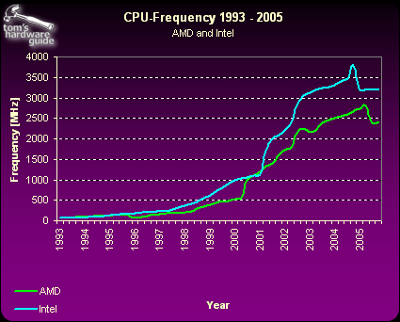
Computer Speedup
Moore’s Law: “The density of transistors on a chip doubles every 18 months, for the same cost” (1965)
Image: Tom’s Hardware and not subject to the Creative Commons license applicable to the rest of this work.
Image: Tom’s Hardware

Slide 5
Scope of problems
What can you do with 1 computer?
What can you do with 100 computers?
What can you do with an entire data center?

Slide 6

Distributed problems
Rendering multiple frames of high-quality animation
Image: DreamWorks Animation and not subject to the Creative Commons license applicable to the rest of this work.

Slide 7
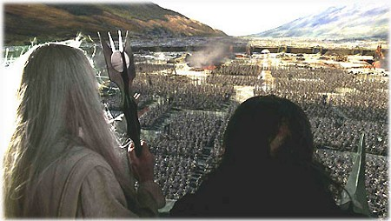

Distributed problems
Simulating several hundred or thousand characters
Happy Feet © Kingdom Feature Productions;
Lord of the Rings © New Line Cinema, neither image is subject to the Creative Commons license applicable to the rest of the work.

Slide 8
Distributed problems
Indexing the web (Google)
Simulating an Internet-sized network for networking experiments (PlanetLab)
Speeding up content delivery (Akamai)
What is the key attribute that all these examples have in common?

Slide 9
Parallel vs. Distributed
Parallel computing can mean:
  Vector processing of data
  Multiple CPUs in a single computer
Distributed computing is multiple CPUs across many computers over the network

Slide 10

A Brief History… 1975-85
Parallel computing was favored in the early years
Primarily vector-based at first
Gradually more thread-based parallelism was introduced
Image: Computer Pictures Database and Cray Research Corp and is not subject to the Creative Commons license applicable to the rest of this work.

Slide 11
A Brief History… 1985-95
“Massively parallel architectures” start rising in prominence
Message Passing Interface (MPI) and other libraries developed
Bandwidth was a big problem

Slide 12
A Brief History… 1995-Today
Cluster/grid architecture increasingly dominant
Special node machines eschewed in favor of COTS technologies
Web-wide cluster software
Companies like Google take this to the extreme

Slide 13
Parallelization & Synchronization

Slide 14
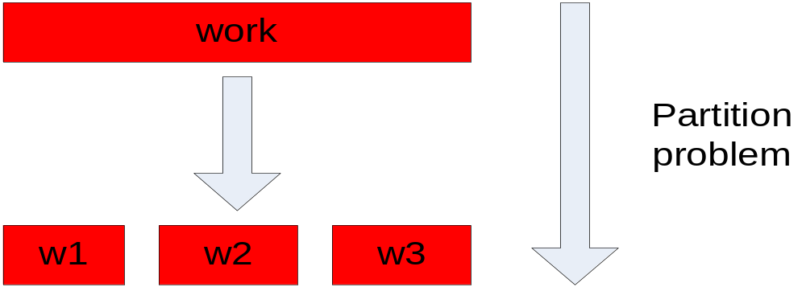
Parallelization Idea
Parallelization is “easy” if processing can be cleanly split into n units:

Slide 15
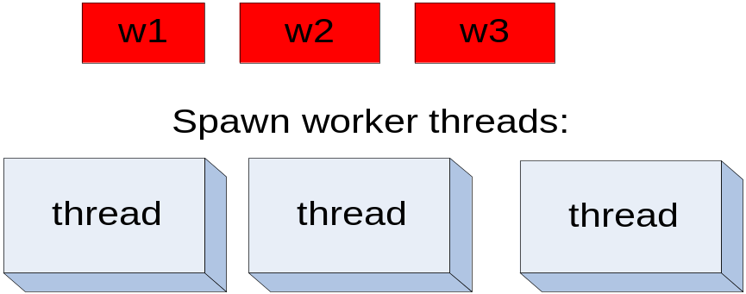
Parallelization Idea (2)
In a parallel computation, we would like to have as many threads as we have processors. e.g., a four-processor computer would be able to run four threads at the same time.

Slide 16
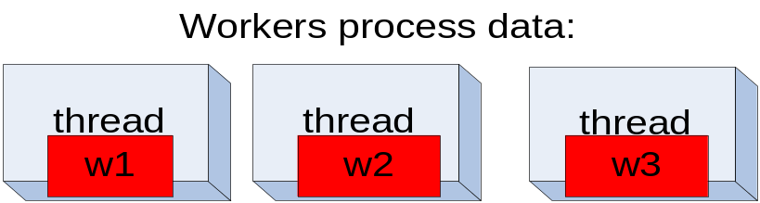
Parallelization Idea (3)

Slide 17
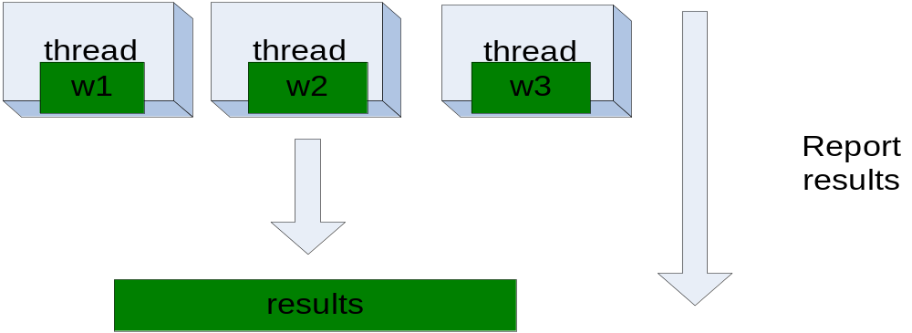
Parallelization Idea (4)

Slide 18
Parallelization Pitfalls
But this model is too simple!
How do we assign work units to worker threads?
What if we have more work units than threads?
How do we aggregate the results at the end?
How do we know all the workers have finished?
What if the work cannot be divided into completely separate tasks?
What is the common theme of all of these problems?

Slide 19
Parallelization Pitfalls (2)
Each of these problems represents a point at which multiple threads must communicate with one another, or access a shared resource.
Golden rule: Any memory that can be used by multiple threads must have an associated synchronization system!

Slide 20
What is Wrong With This?
Thread 1:
void foo() {
x++;
y = x;
}
Thread 2:
void bar() {
y++;
x+=3;
}
If the initial state is y = 0, x = 6, what happens after these threads finish running?
Notes:
There are multiple possible final states. Y is definitely a problem, because we don’t know if it will be “1” or “7”… but X can also be 7, 10, or 11!

Slide 21
Multithreaded = Unpredictability
Many things that look like “one step” operations actually take several steps under the hood:
Thread 1:
void foo() {
eax = mem[x];
inc eax;
mem[x] = eax;
ebx = mem[x];
mem[y] = ebx;
}
Thread 2:
void bar() {
eax = mem[y];
inc eax;
mem[y] = eax;
eax = mem[x];
add eax, 3;
mem[x] = eax;
}
When we run a multithreaded program, we don’t know what order threads run in, nor do we know when they will interrupt one another.
Notes:
Inform students that the term we want here is “race condition”

Slide 22
Multithreaded = Unpredictability
This applies to more than just integers:
Pulling work units from a queue
Reporting work back to master unit
Telling another thread that it can begin the “next phase” of processing
… All require synchronization!

Slide 23
Synchronization Primitives
A synchronization primitive is a special shared variable that guarantees that it can only be accessed atomically.
Hardware support guarantees that operations on synchronization primitives only ever take one step

Slide 24
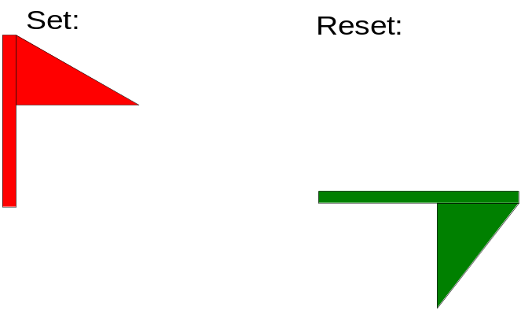
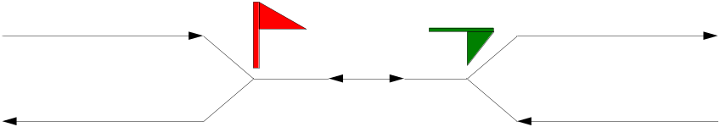
Semaphores
A semaphore is a flag that can be raised or lowered in one step
Semaphores were flags that railroad engineers would use when entering a shared track
Only one side of the semaphore can ever be red! (Can both be green?)

Slide 25
Semaphores
set() and reset() can be thought of as lock() and unlock()
Calls to lock() when the semaphore is already locked cause the thread to block.
Pitfalls: Must “bind” semaphores to particular objects; must remember to unlock correctly

Slide 26
The “corrected” example
Thread 1:
void foo() {
sem.lock();
x++;
y = x;
sem.unlock();
}
Thread 2:
void bar() {
sem.lock();
y++;
x+=3;
sem.unlock();
}
Global var “Semaphore sem = new Semaphore();” guards access to x & y
Notes:
Ask: are there still any problems? (Yes – we still have two possible outcomes. We want some other system that allows us to serialize access on an event.)

Slide 27
Condition Variables
A condition variable notifies threads that a particular condition has been met
Inform another thread that a queue now contains elements to pull from (or that it’s empty – request more elements!)
Pitfall: What if nobody’s listening?
Notes:
Go over wait() / notify() / broadcast() --- must be combined with a semaphore!

Slide 28
The final example
Thread 1:
void foo() {
sem.lock();
x++;
y = x;
fooDone = true;
sem.unlock();
fooFinishedCV.notify();
}
Thread 2:
void bar() {
sem.lock();
if(!fooDone) fooFinishedCV.wait(sem);
y++;
x+=3;
sem.unlock();
}
Global vars: Semaphore sem = new Semaphore(); ConditionVar fooFinishedCV = new ConditionVar(); boolean fooDone = false;

Slide 29
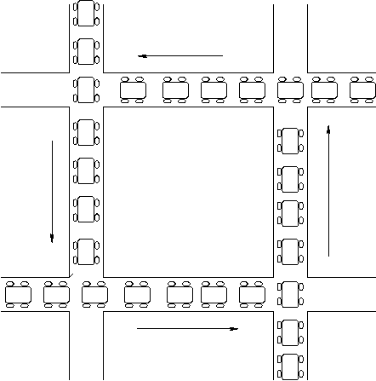
Too Much Synchronization? Deadlock
Synchronization becomes even more complicated when multiple locks can be used
Can cause entire system to “get stuck”
Thread A:
semaphore1.lock();
semaphore2.lock();
/* use data guarded by
semaphores */
semaphore1.unlock();
semaphore2.unlock();
Thread B:
semaphore2.lock();
semaphore1.lock();
/* use data guarded by
semaphores */
semaphore1.unlock();
semaphore2.unlock();
(Image: RPI CSCI.4210 Operating Systems notes)

Slide 30
The Moral: Be Careful!
Synchronization is hard
  Need to consider all possible shared state
  Must keep locks organized and use them consistently and correctly
Knowing there are bugs may be tricky; fixing them can be even worse!
Keeping shared state to a minimum reduces total system complexity

Slide 31
Fundamentals of Networking

Slide 32
Sockets: The Internet = tubes?
A socket is the basic network interface
Provides a two-way “pipe” abstraction between two applications
Client creates a socket, and connects to the server, who receives a socket representing the other side

Slide 33
Ports
Within an IP address, a port is a sub-address identifying a listening program
Allows multiple clients to connect to a server at once

Slide 34
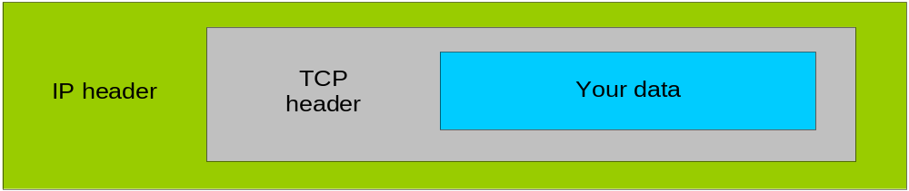
What makes this work?
Underneath the socket layer are several more protocols
Most important are TCP and IP (which are used hand-in-hand so often, they’re often spoken of as one protocol: TCP/IP)
Even more low-level protocols handle how data is sent over Ethernet wires, or how bits are sent through the air using 802.11 wireless…

Slide 35
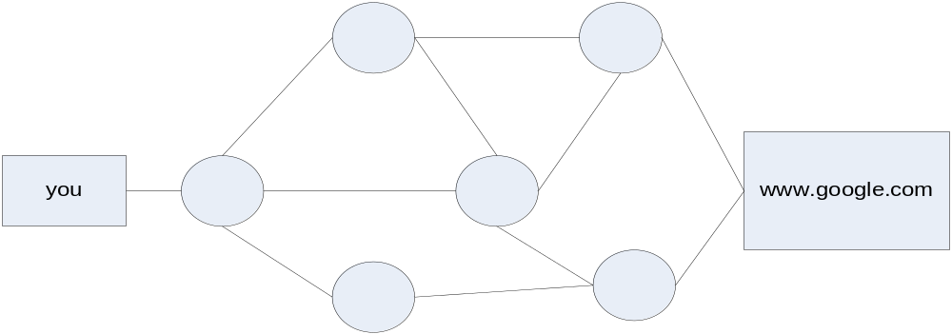
Why is This Necessary?
Not actually tube-like “underneath the hood”
Unlike phone system (circuit switched), the packet switched Internet uses many routes at once

Slide 36
Networking Issues
If a party to a socket disconnects, how much data did they receive?
… Did they crash? Or did a machine in the middle?
Can someone in the middle intercept/modify our data?
Traffic congestion makes switch/router topology important for efficient throughput

Slide 37
Conclusions
Processing more data means using more machines at the same time
Cooperation between processes requires synchronization
Designing real distributed systems requires consideration of networking topology
Next time: How MapReduce works

